Slide 1
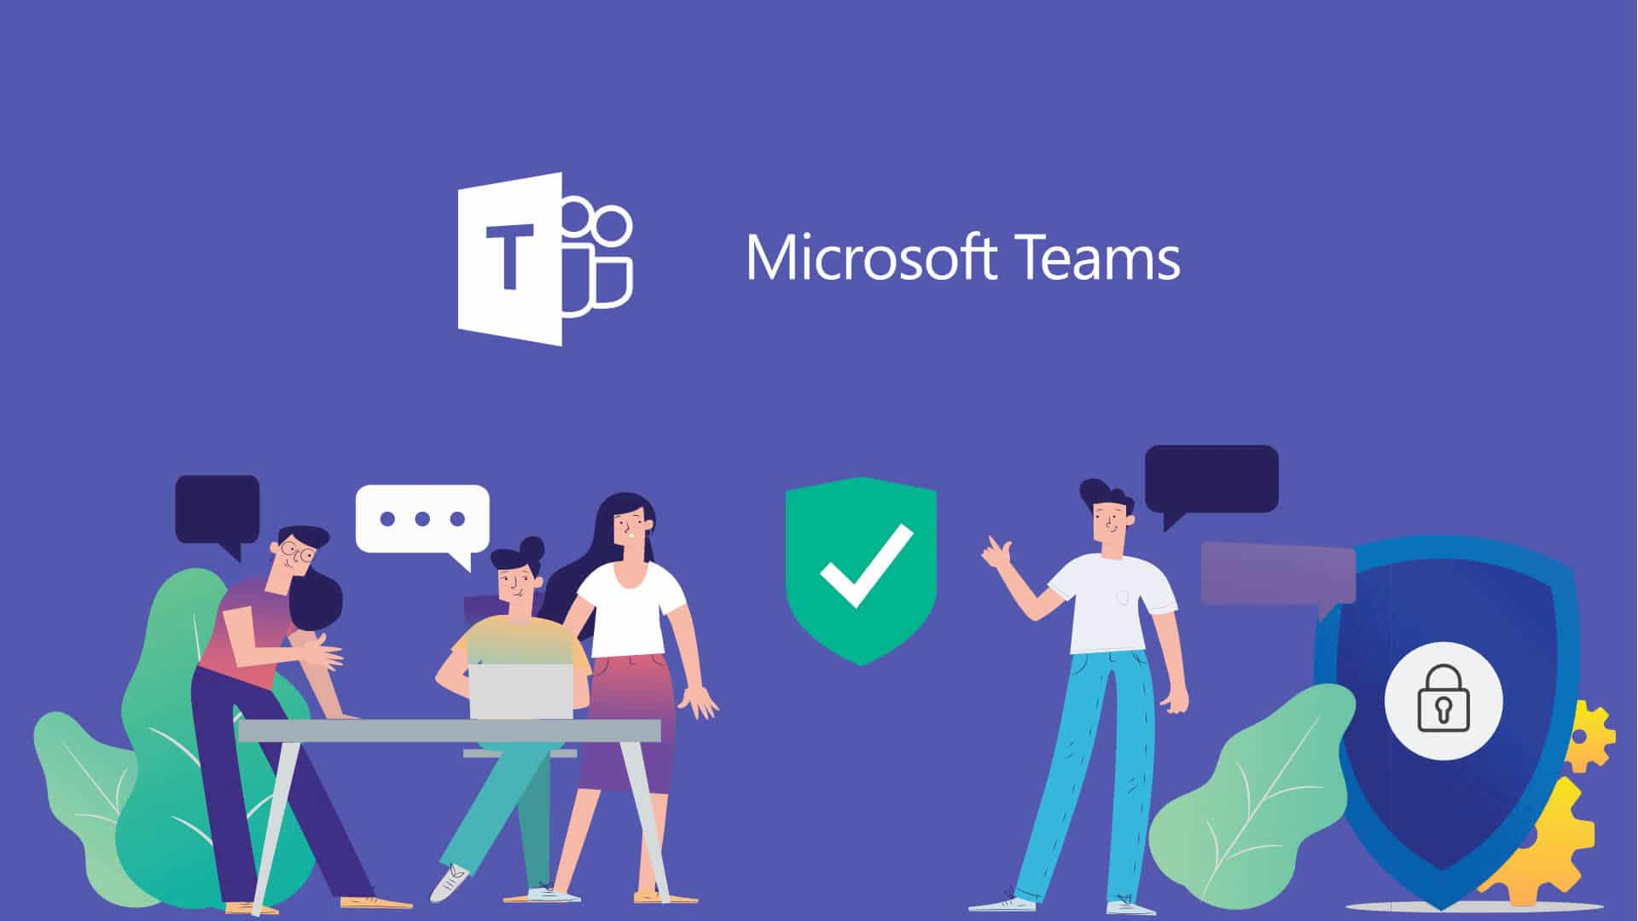

Slide 2
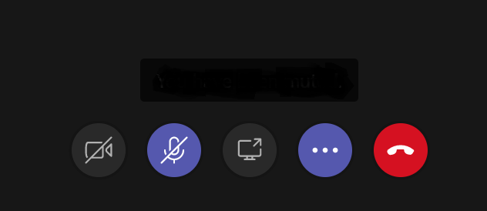
Here are the buttons..
Camera
Microphone
Hang Up

Slide 3
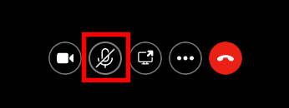
Mute/unmute button

Slide 4


Click this button to mute
and turn off the sound

Slide 5
Click this again to unmute and turn the sound on

Slide 6
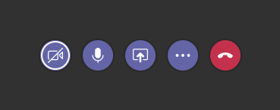
Turn the camera on/off

Slide 7
Click to turn the camera off

Slide 8
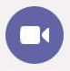
Click again to turn the camera on

Slide 9
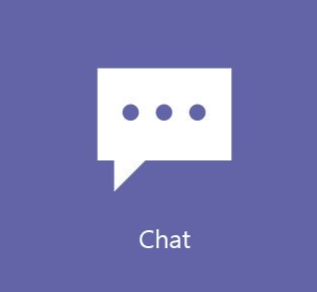
Hello Ahmed, how are you today?
Click to show the chat

Slide 10

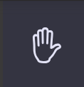
Click to raise your hand

Slide 11

Bye!
Click to show participants

Slide 12


Click to hang up

